Slide 1

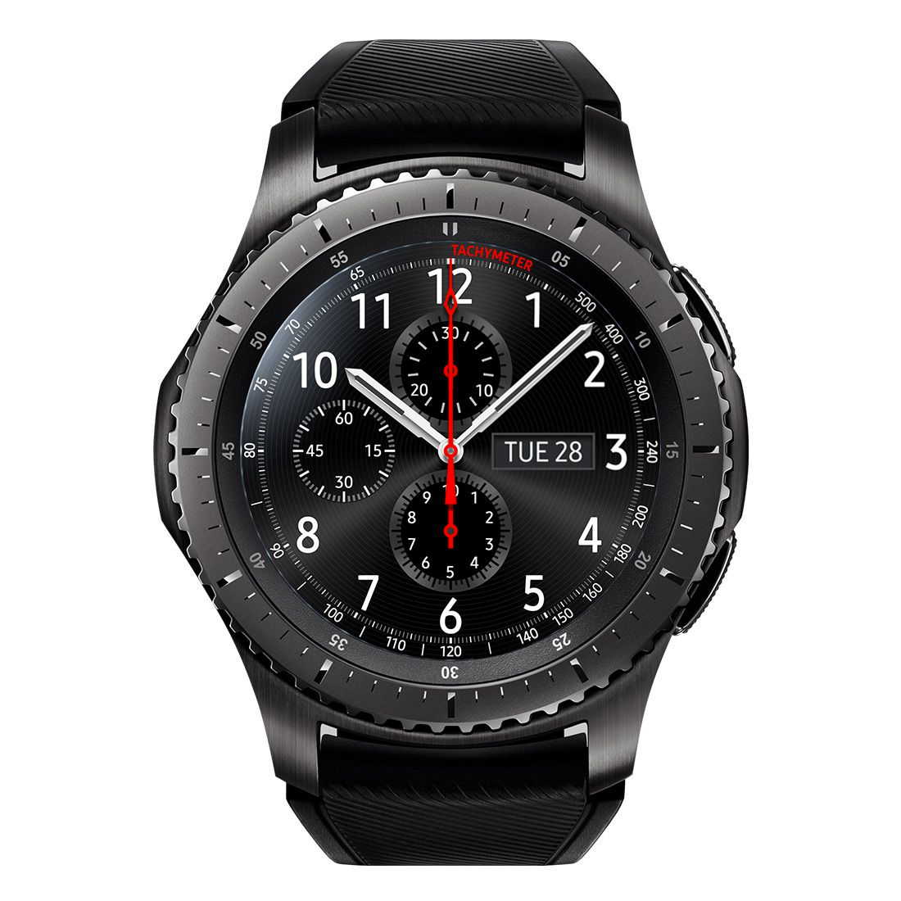
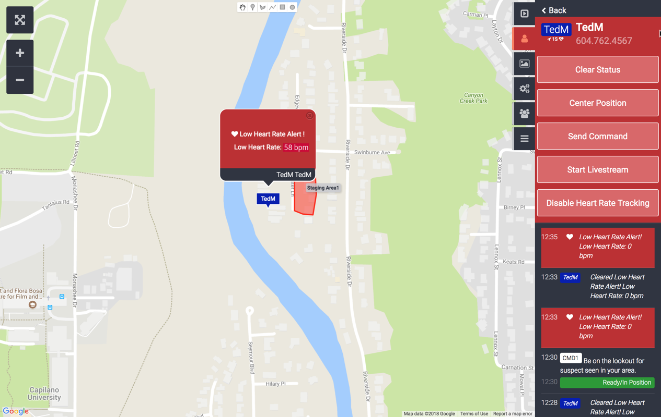
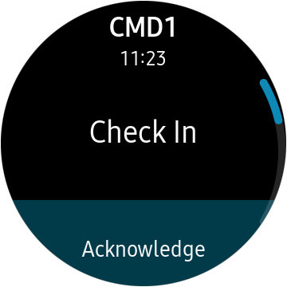
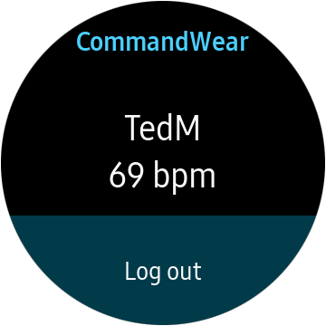
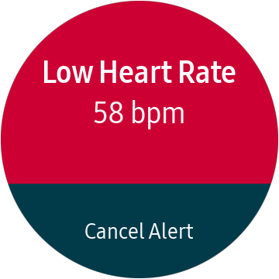
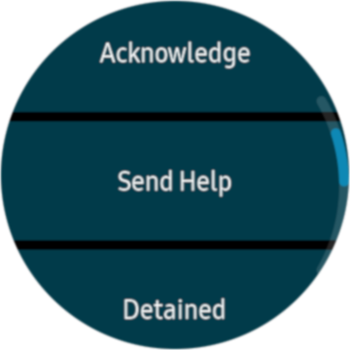
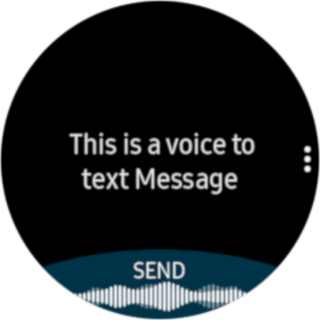
LTE Connected Responder Watch™ App for WearOS-compatible and Samsung Smartwatches*
Keeping Responders and Field Workers CONNECTED, PROTECTED & FULLY AWARE
Covert
App runs in background
Message receipt vibration, audible or silent
Custom response picklist
Voice-to-text message
Controlled
Secure Login
Enable Heart Rate Tracking Remotely
No reliance on smartphone connection
Protected
Heart Rate Alert sent to Commander / Control Center Optional: alert triggers smartphone video/audio streaming
Aware
Visual/Audible Alert Instantly Locates Responder
Two-way secure messaging
Real-time GPS Tracking
* Apple Watch and other smartwatches work with CommandWear for simple messaging functions. Trademarks are the property of COMMANDWEAR SYSTEMS INC.

